Slide 1
GUI-based calculator using Tkinter
By Pandurang Choudhari

Slide 2
Introduction
This is my first project as an intern. I am learning Python basic and advanced coding language for the profile of Data Analyst / Data Scientist.
I have created a simple calculator here using Python coding program.

Slide 3
Object
The main objective is to build a GUI-based calculator in Tkinter using Python coding language.
The calculator is to be built in such a way, wherein all buttons work correctly and the correct output is displayed.

Slide 4
Methods
Import the “Tkinter" module.
Define functions "button_click(), "clear" and calculate for handling button clicks.
Create the main Tkinter window root and set its title.
Create an input field using 'tk.Entry' for displaying and entering expressions.
Create buttons for digits (0-9) and operators (+, -, *, /) using tk.Button and link the button_click function to each button to update the input field.
Create Clear (C), Equal to (=) buttons and add a Backspace (←) button. This backspace button helps to delete the character from the input field one character at a time.
Finally, start the Tkinter main loop with root.mainloop() to get the final calculator output.

Slide 5
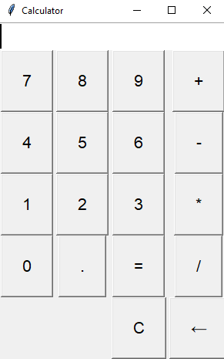
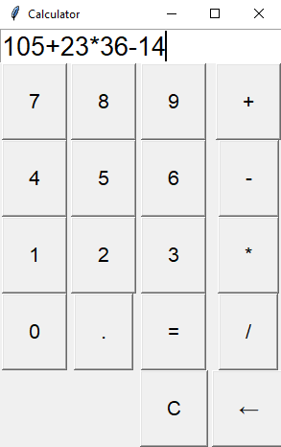
Result
As a result,
the calculator
is built, wherein all
the previously described
functions work properly.

Slide 6
Conclusion
A basic calculator is created using Tkinter library in Python.
The calculator has all the basic functionalities like addition, subtraction, multiplication, division, equal to, backspace and clear.

